Slide 1

System Software

Slide 2
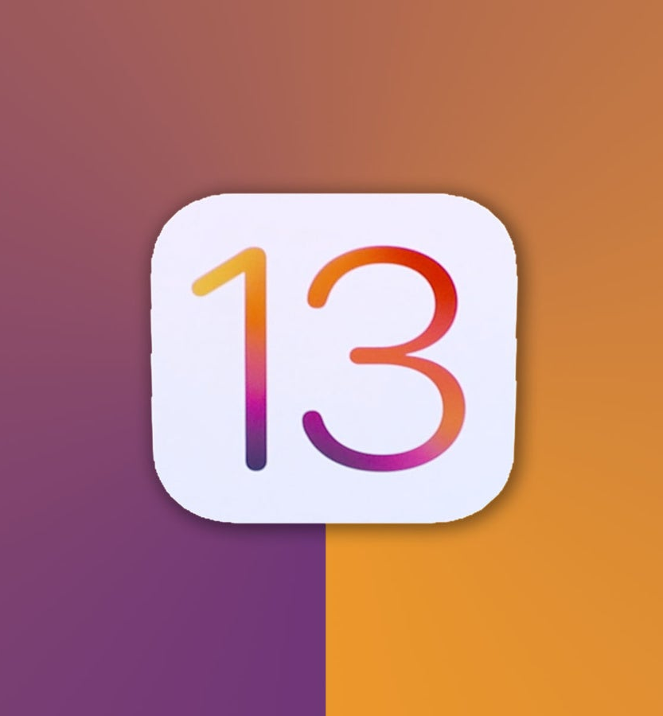
Proprietary operating systems
Microsoft Windows
MacOS
Xbox
iOS
Notes:
Proprietary operating systems are paid systems. You have to have a license to use it.

Slide 3
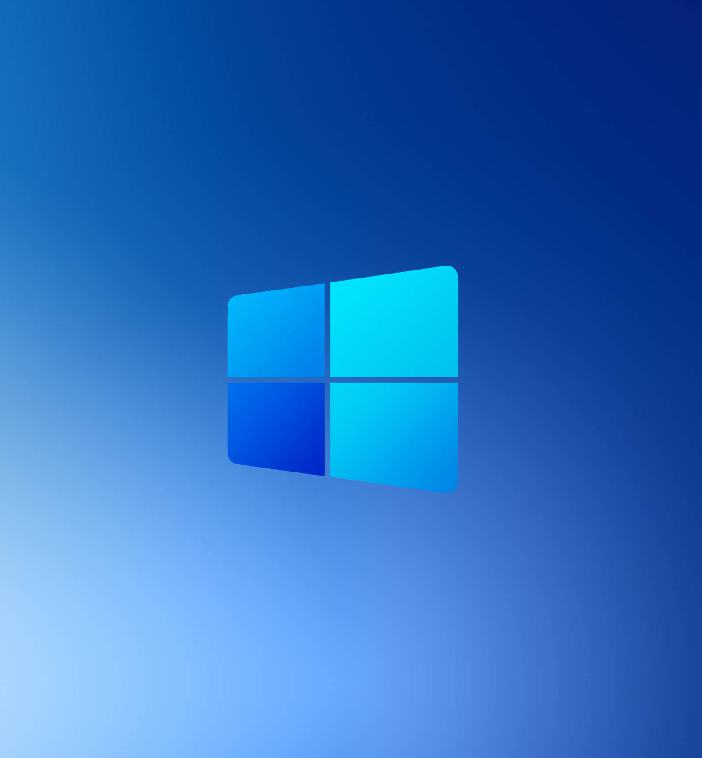
Proprietary operating systems
Advantages
Simplified Experience
Disadvantages
Limited customizability
Support is provided
Updates and bug fixes
The source code can't be modified by users
It is not free
Notes:
The advantages of proprietary systems is the simplified experience, support is provided and updates and bugs are fixed for you.
The disadvantages are the limited customisability, the code that cant be modified and its not free.

Slide 4

Open source operating systems
Linux
Android
SteamOS
Chromnium
Notes:
Some examples of open source operating systems are Linux, Android, Steam and chromnium.

Slide 5
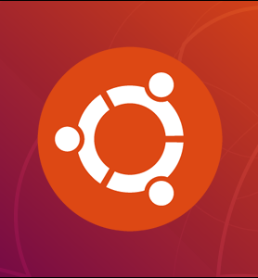
Open source operating systems
Code is customisable
Advantages
Free to use
Hard to learn how to use
Disadvantages
Not many applications run on it
Rely on third party drivers
Notes:
The advantages of open source operating systems are, that its free to use and that the code is customisable.
The disadvantages are, its harder to learn how to use it, not many applications will run on it and it relies on third party drivers.

Slide 6

Network operating system
Novell NetWare
Microsoft Windows Server
UNIX
Notes:
Some examples of Network operating systems are Novell Netware, Microsoft Windows Server and Unix

Slide 7

Network operating system
Advantages
Allows multiple people to connect and share files
Highly stable centralized servers
New technology
Disadvantages
Expensive
Maintenance and updates are required regularly
Notes:
Some advantages of network operating systems are that it allows multiple people to connect and share files, its highly stable centralized servers and the new technology.
The disadvantages are that its expensive and it requires maintenance and updates regularly.

